Slide 1
HRMates PMS Workflow for Employees
Version 1.1

Slide 2
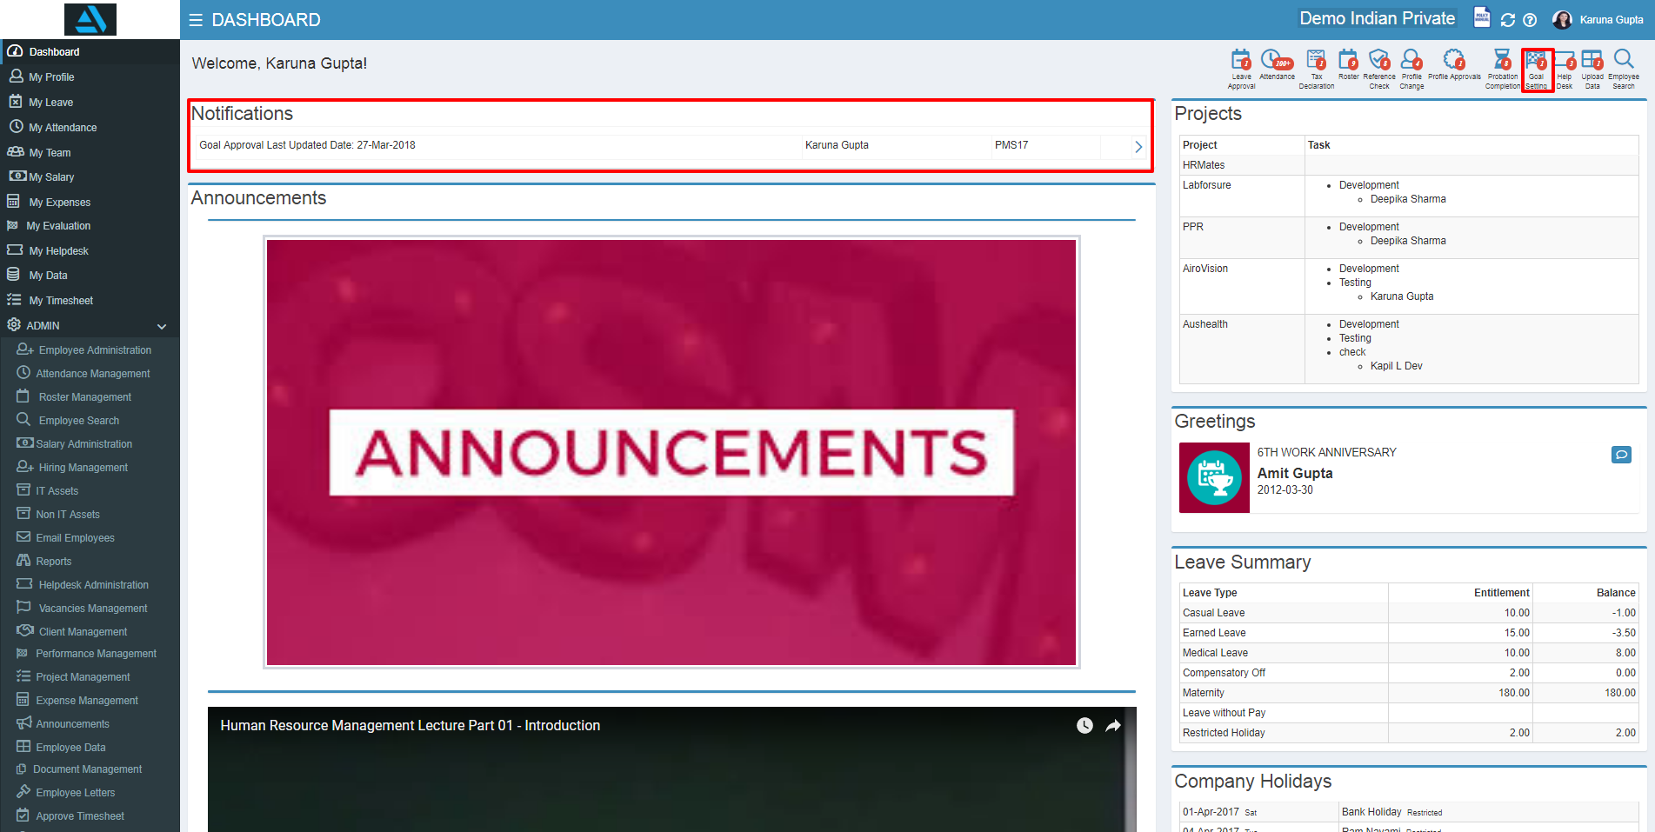
GOAL SETTING
After Login employee can see Notification on dashboard for whom goal setting is open as shown below.
Steps
Click on the Goal Setting Notification icon on top right right
Notification will be displayed on dashboard Notification tab
Click on the arrow (>)

Slide 3
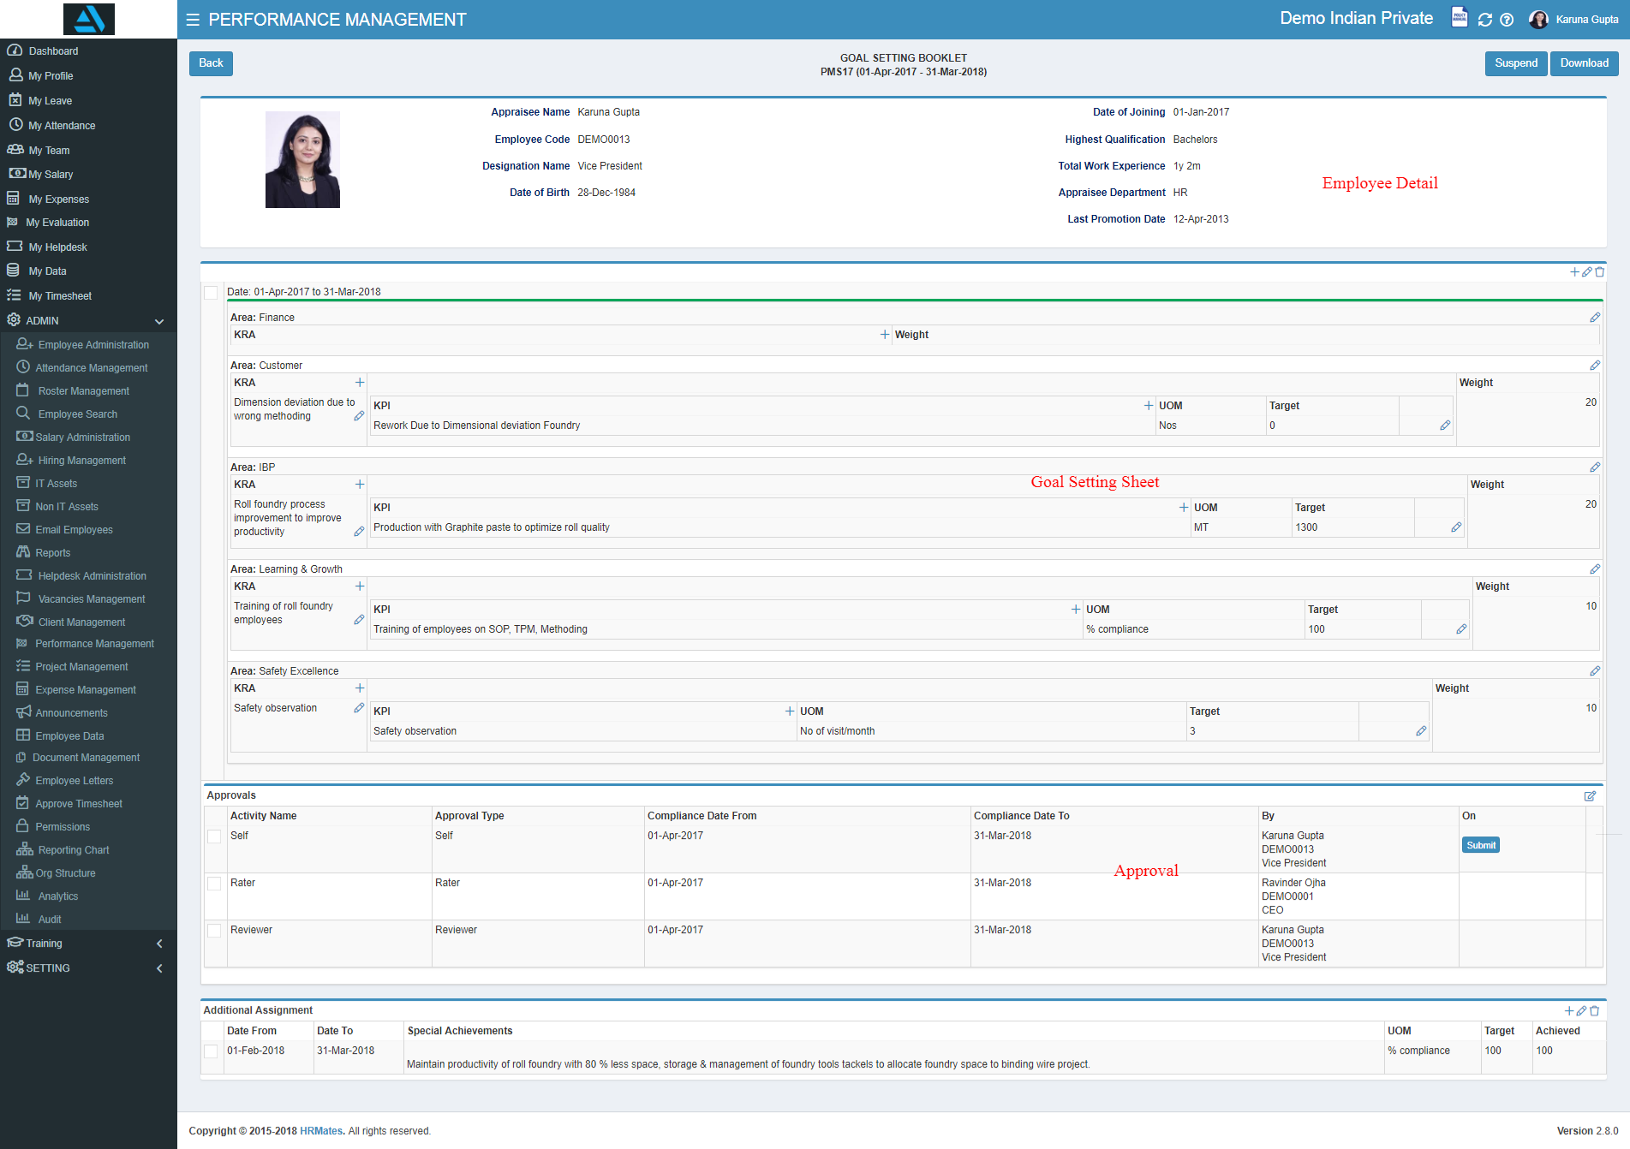
GOAL SETTING Cont...
Goal setting page will look as below.

Slide 4
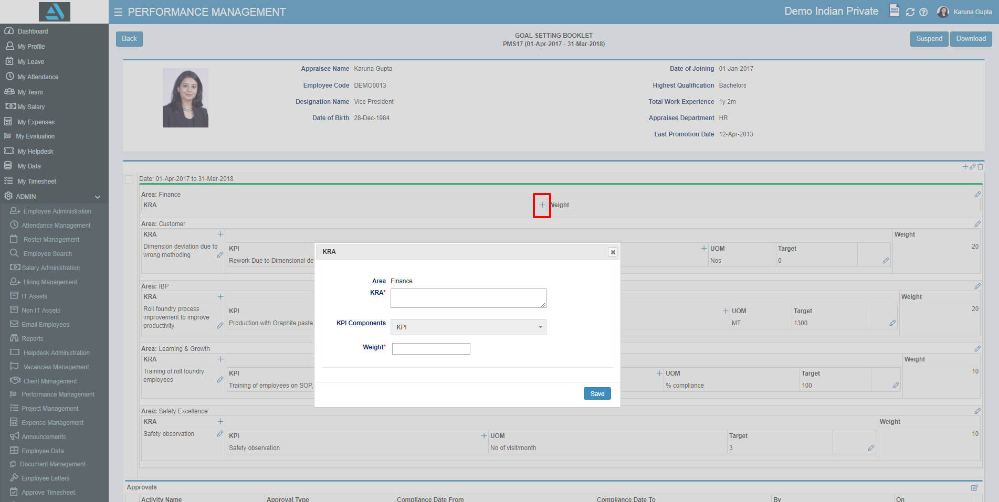
Add KRA
Steps:
Click on + icon
Popup window will open
Add KRA and Weight
Note:
KRA weight will be between 5 to 20
Total weight for KRAs in Safety Area will be 10

Slide 5
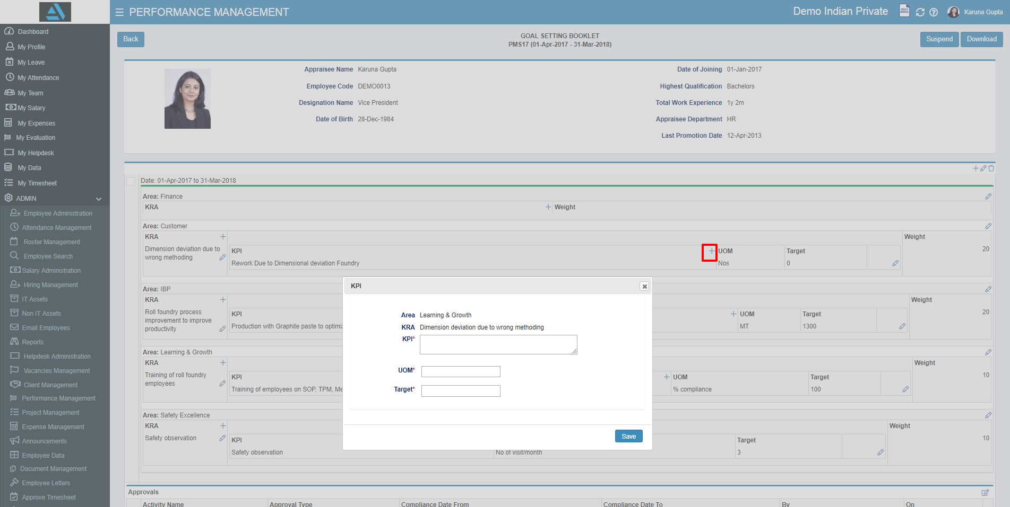
Add KPI
Steps:
Click on add icon
Popup window will open
Add KPI Fields
There is no weight for KPI

Slide 6
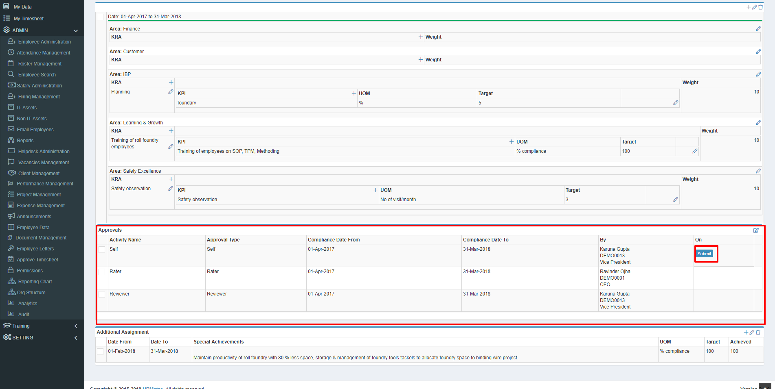
Submit and Approve Goal Setting
Goal Setting will be Submitted by Employee and Approved by Rater and Reviewer
Employee can’t submit the sheet till KRA and KPI are filled for all areas
In Case Goal Setting is Rejected by Rater or Approver it will come back to Employee

Slide 7
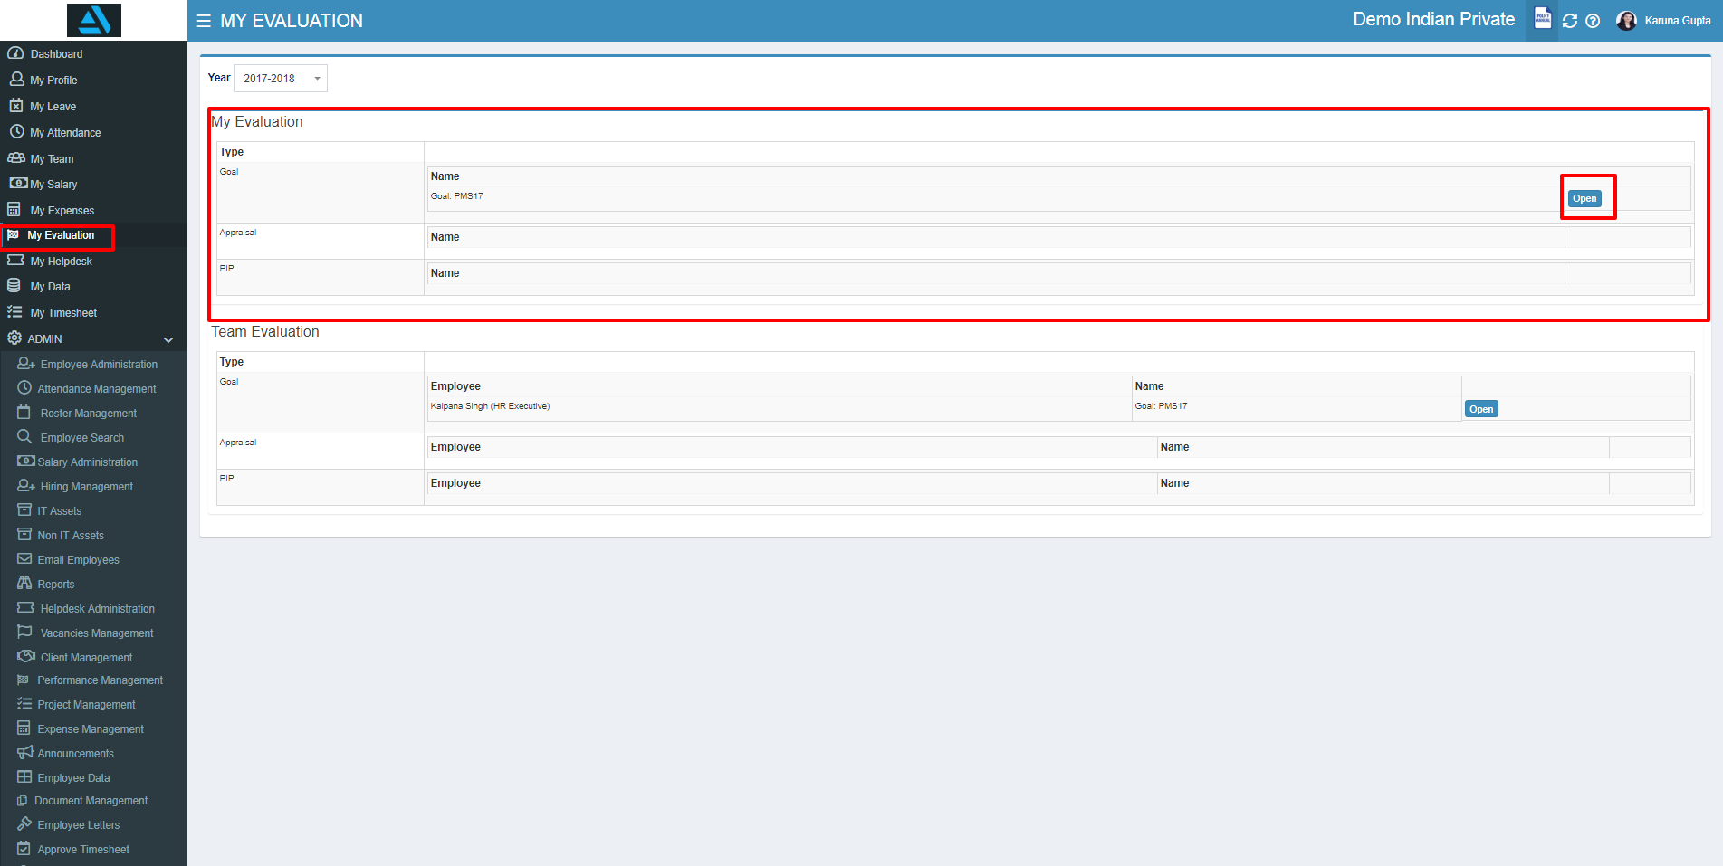
View Goal Settings
Employees can see there Goal Settings from My Evaluations Link
Manager can see their team Goal setting in read only form under Team Evaluation Under My Evaluations

Slide 8
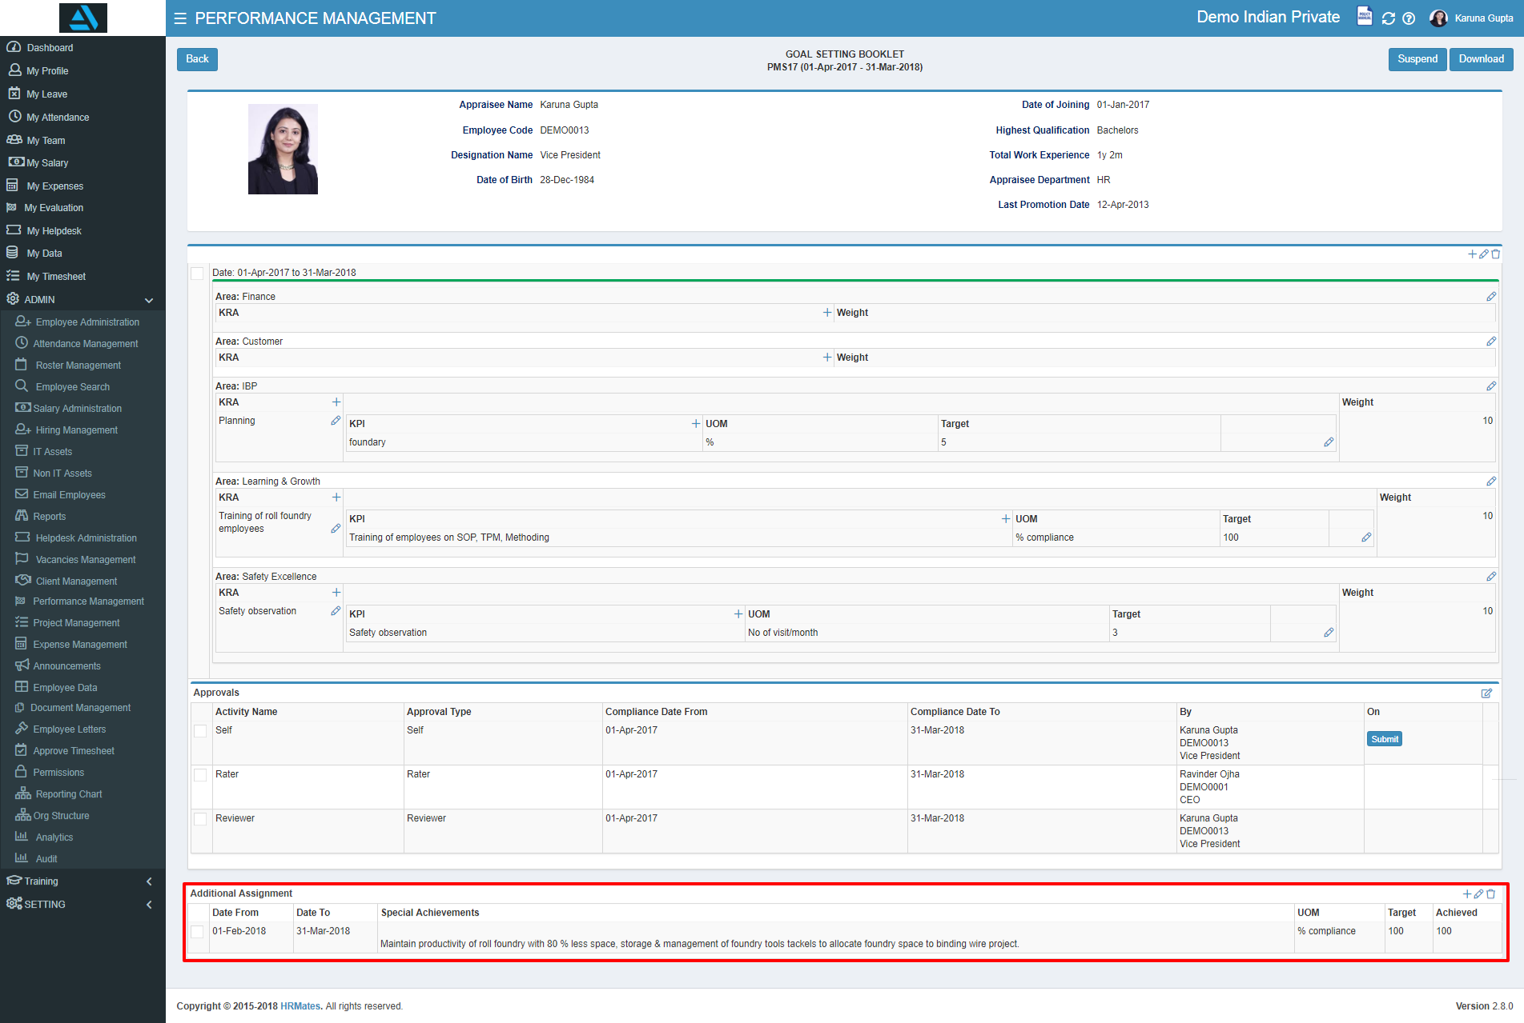
View Goal Settings Cont…
Goal Setting sheet in read only will be viewed as below:
Note:
Only Additional assignment will be editable after Goal booklet gets Approved.

Slide 9
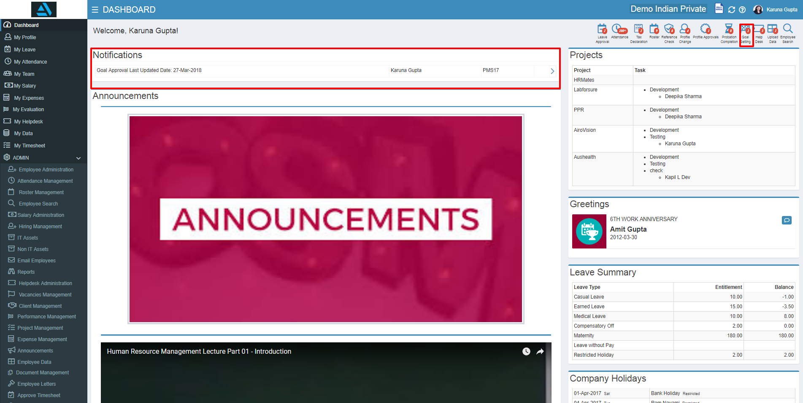
APPRAISAL
When Appraisal is opened for the Employee, Employee will get an Email and also Notification in Dashboard.
Steps
Click on the Appraisal Notification icon on top right right
Notification will be displayed on dashboard Notification tab
Click on the arrow (>)

Slide 10
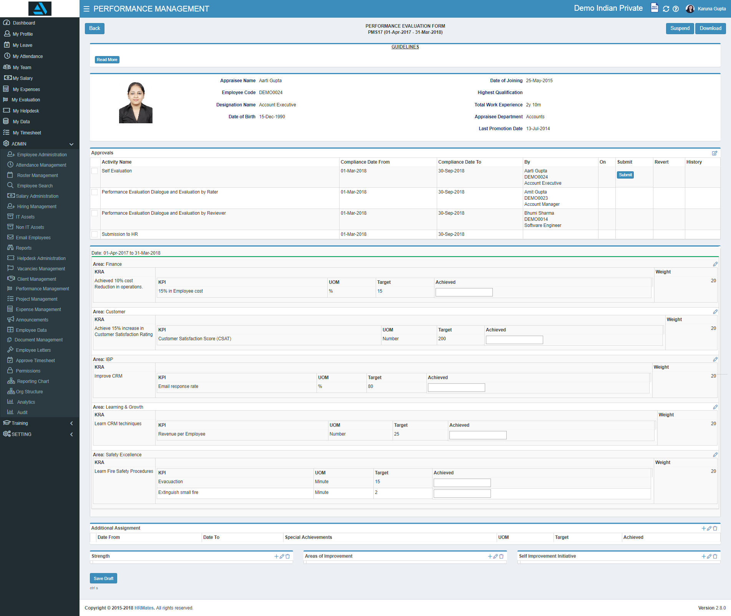
APPRAISAL Cont...
Appraisal Booklet will look like below.
After Completing Appraisal Form Click on Approve Button to move the Form to Next Stage.
To Reject Click on Reject Button. After Reject the Form will move back to First Stage
Note:
All the Data Field at of Goal Setting will be non editable

Slide 11
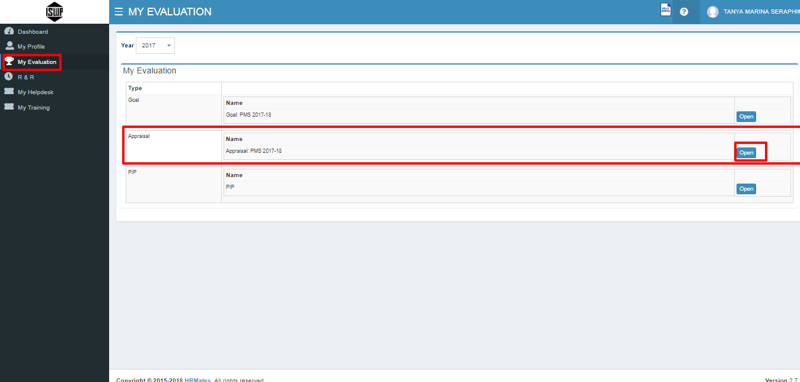
Past Appraisals
Once all the activity are approved by the respective authority booklet can be seen in read only form from My Evaluation link

Slide 12
Past Appraisals Cont...
Appraisal Page will look as below

Slide 13
THANK YOU !

